Slide 1
Heart Disease Prediction Using Machine Learning
Manoj Mannem – 700725556
Kinoree Meda - 700732653

Slide 2
Role/Responsibilities and Contribution in project:
Manoj Mannem -
Exploratory Data Analysis (EDA)
Building the model using Logistic Regression, Naive Bayes, Random Forest
Comparison of all the machine learning models
Kinoree Meda -
Data Analysis
Building the model using SVM, K-Nearest Neighbors, Decision Tree
Comparison of all the machine learning models

Slide 3

Motivation:
The main motivation of doing this research is to present a heart disease prediction model for the prediction of occurrence of heart disease.
Further, this research work is aimed towards identifying the best classification algorithm for identifying the possibility of heart disease in a patient.
Although these are commonly used machine learning algorithms, the heart disease prediction is a vital task involving highest possible accuracy.
Hence, the six algorithms are evaluated at numerous levels and types of evaluation strategies. This will provide researchers and medical practitioners to establish a better.

Slide 4
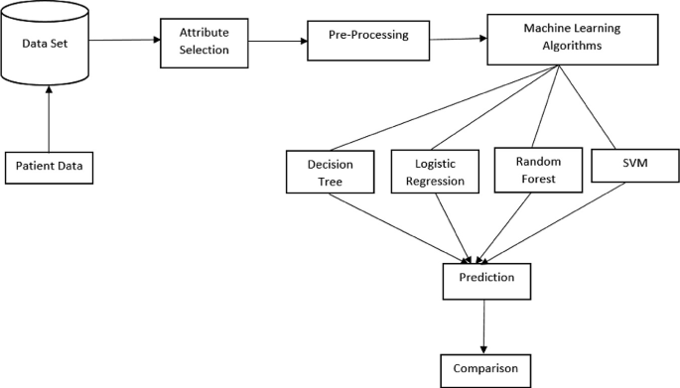
Objectives:
The objective of this project is to check whether the patient is likely to be diagnosed with any cardiovascular heart diseases based on their medical attributes such as gender, age, chest pain, fasting sugar level, etc.
A dataset is selected from the UCI repository with patient’s medical history and attributes.
We use six algorithms among which the most efficient algorithm is Random Forest which gives us the accuracy of 90.16%. Next Logistic Regression and Naïve Bayes with an accuracy of 85.25%.
Finally, we categorize patients according to whether they are at risk of developing a heart condition or not.

Slide 5
Related Work:
Sabarinathan Vachiravel et al. [2] devised a decision machine learning system to predict cardiac disease and used decision trees to reach 85% accuracy.
Apurb Rajdhan et al’s [3] analysis of cardiovascular illness used ML algorithms such decision trees, logistic regression, random forests, and nave bayes, and they achieved accuracy of 81%, 85%, 90%, and 85%, respectively.
A. Lakshmanrao et alresearch .’s[4] for the diagnosis of heart disease included a number of data mining and gradient boosting methods. For managing unbalanced datasets, the authors used a variety of sampling approaches.
From Kaggle, a dataset titled "Framingham heart disease" was gathered. 4220 patient records are included in the dataset, which comprises 15 characteristics. They employed many algorithms for boosting, such as Adaboost and Gradient boosting, and they got accuracy of 78% and 88%, respectively. However, they only achieved an accuracy of 61% for Naive Bayes and 66% for Logistic Regression.

Slide 6
Problem Statement:
The major challenge in heart disease is its detection. There are instruments available which can predict heart disease but either it are expensive or are not efficient to calculate chance of heart disease in human.
Early detection of cardiac diseases can decrease the mortality rate and overall complications.
However, it is not possible to monitor patients everyday in all cases accurately and consultation of a patient for 24 hours by a doctor is not available since it requires more sapience, time and expertise.
Since we have a good amount of data in today’s world, we can use various machine learning algorithms to analyze the data for hidden patterns. The hidden patterns can be used for health diagnosis in medicinal data.

Slide 7
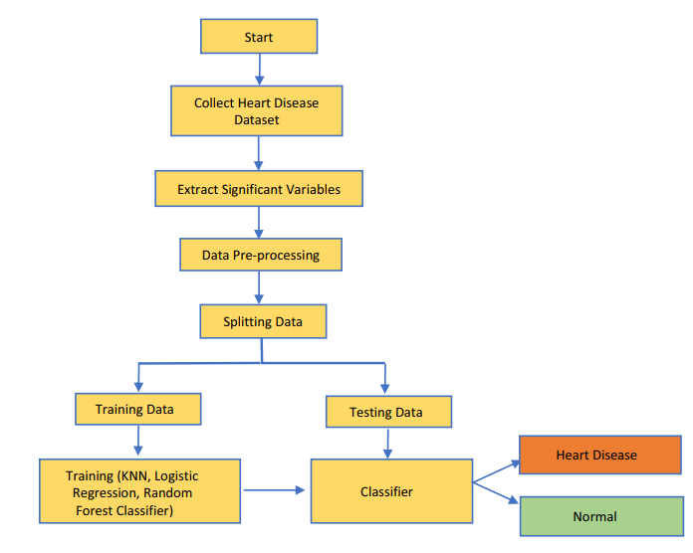
Proposed Solution:
The data is preprocessed into the required format. The data is then divided into two parts training and testing data. This system is implemented using the following modules.
1.) Collection of Dataset
2.) Selection of attributes
3.) Data Pre-Processing
4.) Balancing of Data
5.) Disease Prediction

Slide 8
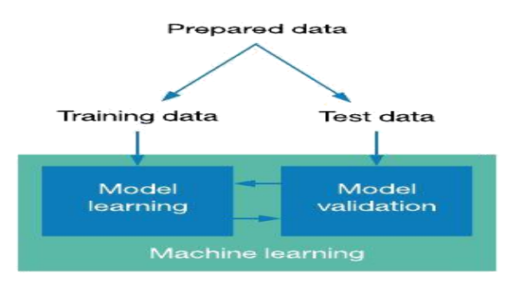
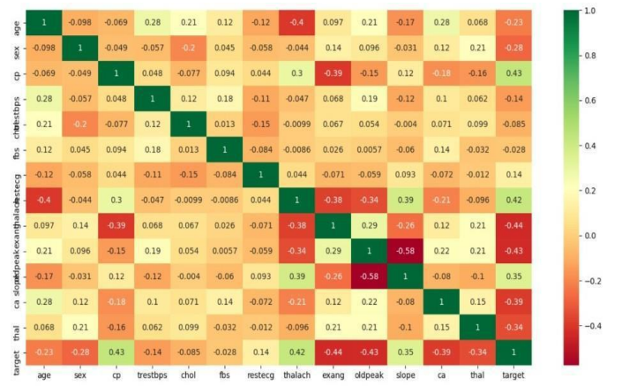
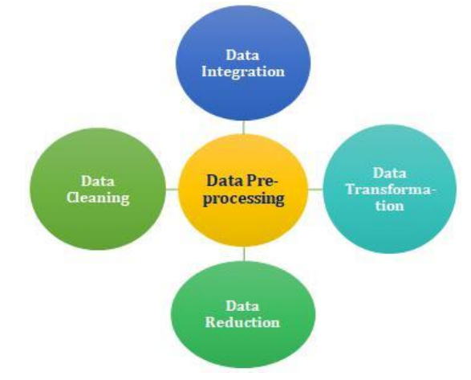
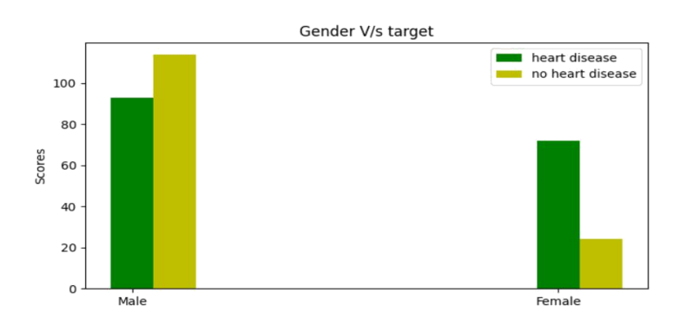
1) Collection of Dataset
2) Selection of attributes
3) Data Pre-processing
4) Balancing of Data

Slide 9
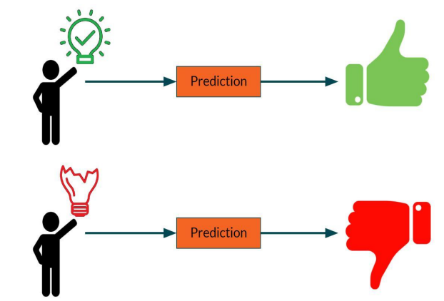
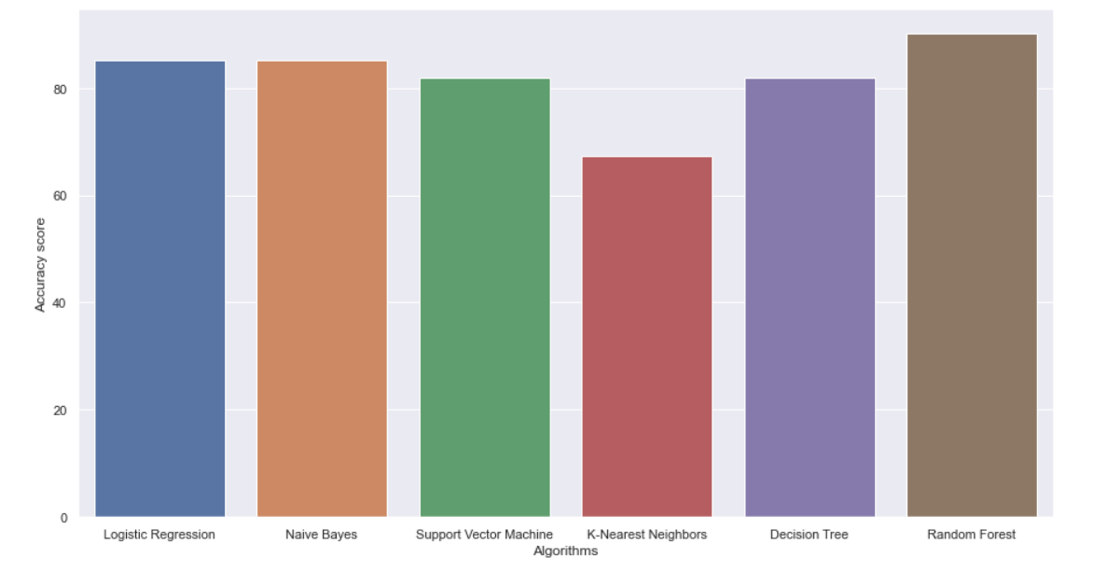
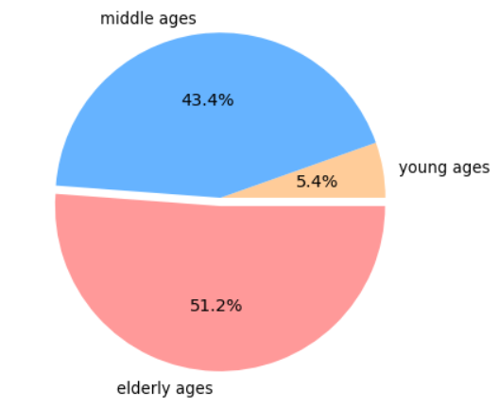
5) Disease Prediction
Results/Simulations:
Comparison between different ML Models

Slide 10
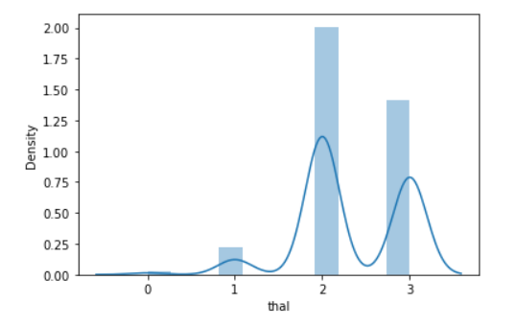
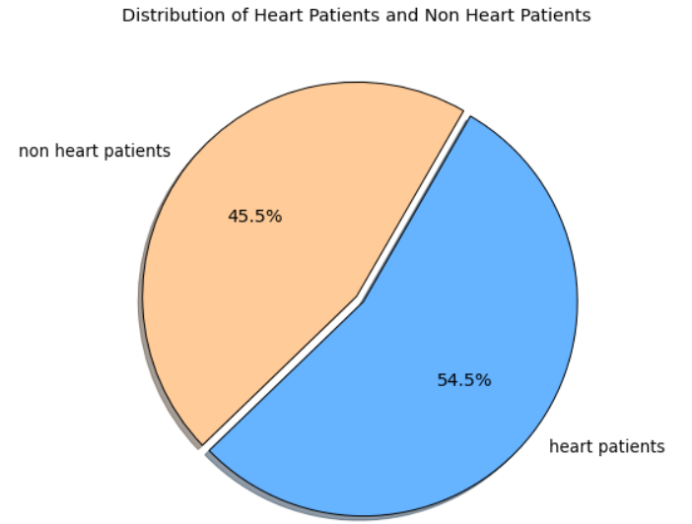
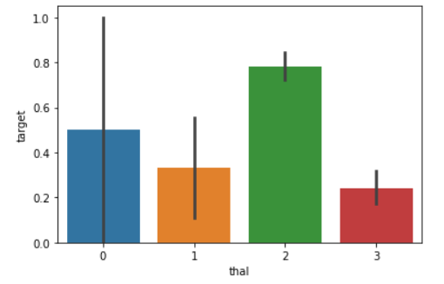

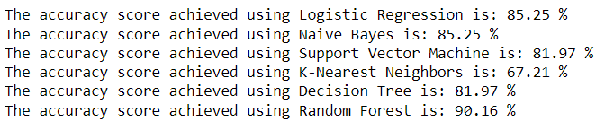

Slide 11
References:
Umair Shafique, Fiaz Majeed, Haseeb Qaiser, Irfan Ul Mustafa “Data Mining In Healthcare For Heart Diseases”, International Journal Of Innovation And Applied Studies Issn 2028-9324 Vol. 10, Issue 4, (2015), Pp. 1312-1322.
V. Sabarinathan “Diagnosis Of Heart Disease Using Decision Tree”, International Journal Of Research In Computer Applications & Information Technology Vol. 2, Issue 6, (2014), Pp. 74-79
Apurb Rajdhan, “Heart Disease Prediction Using Machine Learning”, International Journal Of Engineering Research & Technology (Ijert)Issn: 2278-0181 Vol. 9 Issue 04, April-2020
A. Lakshmanarao,Y.Swathi, P.Sri Sai Sundareswarar, 'Machine Learning Techniques For Heart Disease Prediction” International Journal Of Scientific & Technology Research (2019) Vol. 8, Issue 11, November 2019 Issn 2277-8616

